Slide 1


Veritas: Prompt—>LLM-Generated Conjunctive Normal Form—>Structural Verilog Code
Prithwish Basu Roy, Akashdeep Saha, Manaar Alam, Johann Knechtel, Michalis Maniatakos, Ozgur Sinanoglu, Ramesh Karri

Slide 2
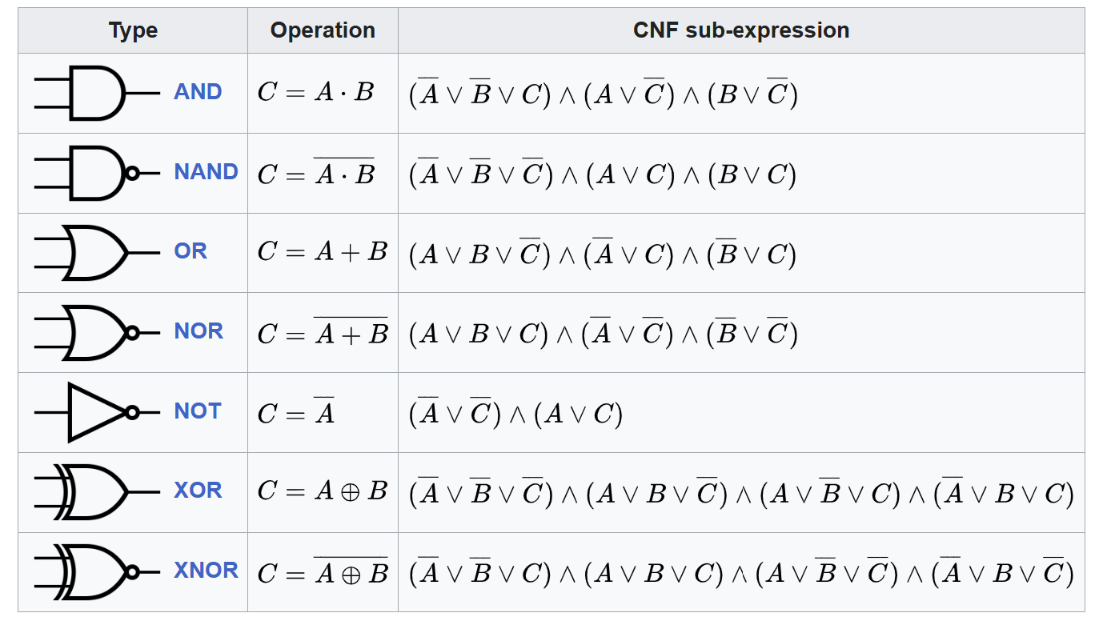
Conjunctive Normal Form of Logic Gates
A logic gate can be expressed in the Conjunctive Normal Form (CNF)

Slide 3
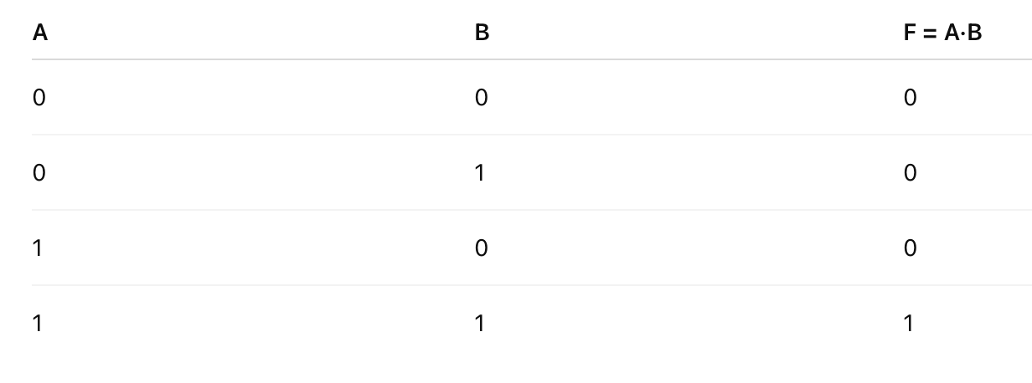
Conjunctive Normal Form of AND Gate
A logic gate can be expressed in the Conjunctive Normal Form (CNF)
Notes:
F=(A+B) AND (A+ not B) AND (not A + B)

Slide 4
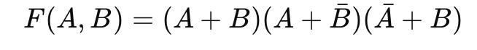
Conjunctive Normal Form of AND Gate
A logic gate can be expressed in the Conjunctive Normal Form (CNF)

Slide 5
CNF ↔ Logic Design
Logic designs can be represented as a conjunction of Tseytin transformations of basic gates. (https://en.wikipedia.org/wiki/Tseytin_transformation)
From the CNF corresponding verilog can be obtained

Slide 6
Produce verilog Deterministically?
Can we integrate verification and testing into the generation phase? Yes
Can we generate accurate code that does not require testing? Yes

Slide 7
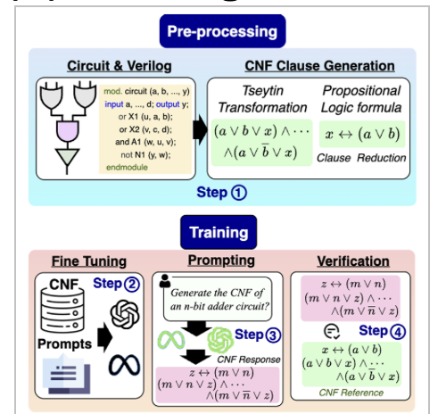
VeriCNF Flow Stage 1: Preprocessing
// Full Adder (gate-level)
module full_adder_gate (
input wire a,
input wire b,
input wire cin,
output wire sum,
output wire cout
);
// internal wires
wire ab_xor;
wire a_and_b, b_and_cin, a_and_cin;
// XOR chain for sum
xor (ab_xor, a, b); // ab_xor = a ^ b
xor (sum, ab_xor, cin);// sum = (a ^ b) ^ cin
// AND-OR network for carry out
and (a_and_b, a, b); // a&b
and (b_and_cin, b, cin); // b&cin
and (a_and_cin, a, cin); // a&cin
or (cout, a_and_b, b_and_cin, a_and_cin); // cout = a&b | b&cin | a&cin
endmodule
Prepare training dataset: prompt describing verilog
Reference verilog is taken
Prompt: Give me a 1-bit full adder with input a,b, cin and outputs sum, cout
Notes:
Can you explain this step with a verilog and equivalent Tseytin, CNF, and PLF formulae

Slide 8
VeriCNF Flow Stage 1: Preprocessing
// Full Adder (gate-level)
module full_adder_gate (
input wire a,
input wire b,
input wire cin,
output wire sum,
output wire cout
);
// internal wires
wire ab_xor;
wire a_and_b, b_and_cin, a_and_cin;
// XOR chain for sum
xor (ab_xor, a, b); // ab_xor = a ^ b
xor (sum, ab_xor, cin);// sum = (a ^ b) ^ cin
// AND-OR network for carry out
and (a_and_b, a, b); // a&b
and (b_and_cin, b, cin); // b&cin
and (a_and_cin, a, cin); // a&cin
or (cout, a_and_b, b_and_cin, a_and_cin); // cout = a&b | b&cin | a&cin
endmodule
sum: (a ∨ b ∨ ¬ab_xor) ∧ (a ∨ ¬b ∨ ab_xor) ∧ (¬a ∨ b ∨ ab_xor) ∧ (¬a ∨ ¬b ∨ ¬ab_xor)
∧ (ab_xor ∨ cin ∨ ¬sum) ∧ (ab_xor ∨ ¬cin ∨ sum) ∧ (¬ab_xor ∨ cin ∨ sum) ∧ (¬ab_xor ∨ ¬cin ∨ ¬sum)
cout: (¬a ∨ ¬b ∨ cout) ∧ (¬a ∨ ¬cin ∨ cout) ∧ (¬b ∨ ¬cin ∨ cout)
∧ (a ∨ b ∨ ¬cout) ∧ (a ∨ cin ∨ ¬cout) ∧ (b ∨ cin ∨ ¬cout)
Reference verilog is converted to CNF gate by gate
Notes:
Can you explain this step with a verilog and equivalent Tseytin, CNF, and PLF formulae

Slide 9
VeriCNF Flow Stage 1: Preprocessing
Prompt: Give me a 1-bit full adder with input a,b, cin and outputs sum, cout
sum =
(a ∨ b ∨ ¬ab_xor) ∧ (a ∨ ¬b ∨ ab_xor) ∧ (¬a ∨ b ∨ ab_xor) ∧ (¬a ∨ ¬b ∨ ¬ab_xor)
∧ (ab_xor ∨ cin ∨ ¬sum) ∧ (ab_xor ∨ ¬cin ∨ sum) ∧ (¬ab_xor ∨ cin ∨ sum) ∧
(¬ab_xor ∨ ¬cin ∨ ¬sum)
cout =
(¬a ∨ ¬b ∨ cout) ∧ (¬a ∨ ¬cin ∨ cout) ∧ (¬b ∨ ¬cin ∨ cout)
∧ (a ∨ b ∨ ¬cout) ∧ (a ∨ cin ∨ ¬cout) ∧ (b ∨ cin ∨ ¬cout)
Training Data Set: Combinations of Prompt + CNF
Notes:
Can you explain this step with a verilog and equivalent Tseytin, CNF, and PLF formulae

Slide 10
VeriCNF Flow Stage 2: Training

Slide 11
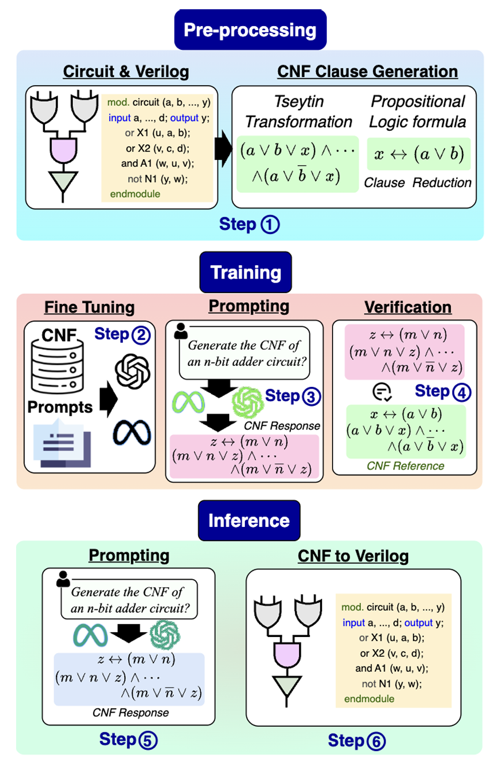
VeriCNF Flow Stage 3: Inference
User provides the LLM with a test prompt
Test Prompt: Generate a 1-bit full adder with input ports a,b, cin and output ports sum, cout

Slide 12
VeriCNF Flow Stage 3: Inference
LLM generates CNF based on test prompt
Test Prompt: Generate a 1-bit full adder with input ports a,b, cin and output ports sum, cout
Fine-tuned LLM
(VeriCNF)
sum =
(a ∨ b ∨ ¬ab_xor) ∧ (a ∨ ¬b ∨ ab_xor) ∧ (¬a ∨ b ∨ ab_xor) ∧ (¬a ∨ ¬b ∨ ¬ab_xor) ∧ (ab_xor ∨ cin ∨ ¬sum) ∧
(ab_xor ∨ ¬cin ∨ sum) ∧ (¬ab_xor ∨ cin ∨ sum) ∧ (¬ab_xor ∨ ¬cin ∨ ¬sum)
cout =
(¬a ∨ ¬b ∨ cout) ∧ (¬a ∨ ¬cin ∨ cout) ∧ (¬b ∨ ¬cin ∨ cout) ∧ (a ∨ b ∨ ¬cout) ∧
(a ∨ cin ∨ ¬cout) ∧ (b ∨ cin ∨ ¬cout)

Slide 13
VeriCNF Flow Stage 3: Inference
INPUT(a)
INPUT(b)
INPUT(cin)
OUTPUT(sum)
OUTPUT(cout)
ab_xor = XOR(a, b)
sum = XOR(ab_xor, cin)
a_and_b = AND(a, b)
b_and_cin = AND(b, cin)
a_and_cin = AND(a, cin)
t1 = OR(a_and_b, b_and_cin)
cout = OR(t1, a_and_cin)
sum =
(a ∨ b ∨ ¬ab_xor) ∧ (a ∨ ¬b ∨ ab_xor) ∧ (¬a ∨ b ∨ ab_xor) ∧ (¬a ∨ ¬b ∨ ¬ab_xor) ∧ (ab_xor ∨ cin ∨ ¬sum) ∧ (ab_xor ∨ ¬cin ∨ sum) ∧ (¬ab_xor ∨ cin ∨ sum) ∧ (¬ab_xor ∨ ¬cin ∨ ¬sum)
cout =
(¬a ∨ ¬b ∨ cout) ∧ (¬a ∨ ¬cin ∨ cout) ∧ (¬b ∨ ¬cin ∨ cout)
∧ (a ∨ b ∨ ¬cout) ∧ (a ∨ cin ∨ ¬cout) ∧ (b ∨ cin ∨ ¬cout)
CNF is deterministically converted to bench

Slide 14
VeriCNF Flow Stage 3: Inference
// Full Adder (gate-level)
module full_adder_gate (
input wire a,
input wire b,
input wire cin,
output wire sum,
output wire cout
);
// internal wires
wire ab_xor;
wire a_and_b, b_and_cin, a_and_cin;
// XOR chain for sum
xor (ab_xor, a, b); // ab_xor = a ^ b
xor (sum, ab_xor, cin);// sum = (a ^ b) ^ cin
// AND-OR network for carry out
and (a_and_b, a, b); // a&b
and (b_and_cin, b, cin); // b&cin
and (a_and_cin, a, cin); // a&cin
or (cout, a_and_b, b_and_cin, a_and_cin);
// cout = a&b | b&cin | a&cin
endmodule
INPUT(a)
INPUT(b)
INPUT(cin)
OUTPUT(sum)
OUTPUT(cout)
ab_xor = XOR(a, b)
sum = XOR(ab_xor, cin)
a_and_b = AND(a, b)
b_and_cin = AND(b, cin)
a_and_cin = AND(a, cin)
t1 = OR(a_and_b, b_and_cin)
cout = OR(t1, a_and_cin)
Convert bench format to equivalent verilog

Slide 15
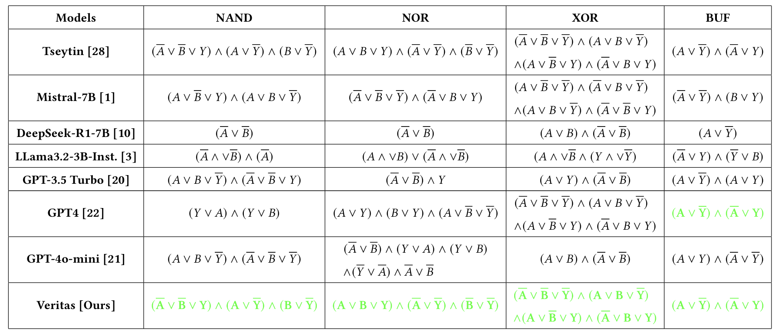
Case 1: CNF Generation by Base Models

Slide 16
Try out veritas collab
•Use google collab implementing Veritas
•https://drive.google.com/file/d/1ysHMvfTkve9Pbqb6toweKuT6EV1fzQ_d/view?usp=sharing
•Try out different designs (add, sub, ect) and configurations (2-bit, 4-bit etc)
•You will need a API Key to access the OpenAI API

Slide 17
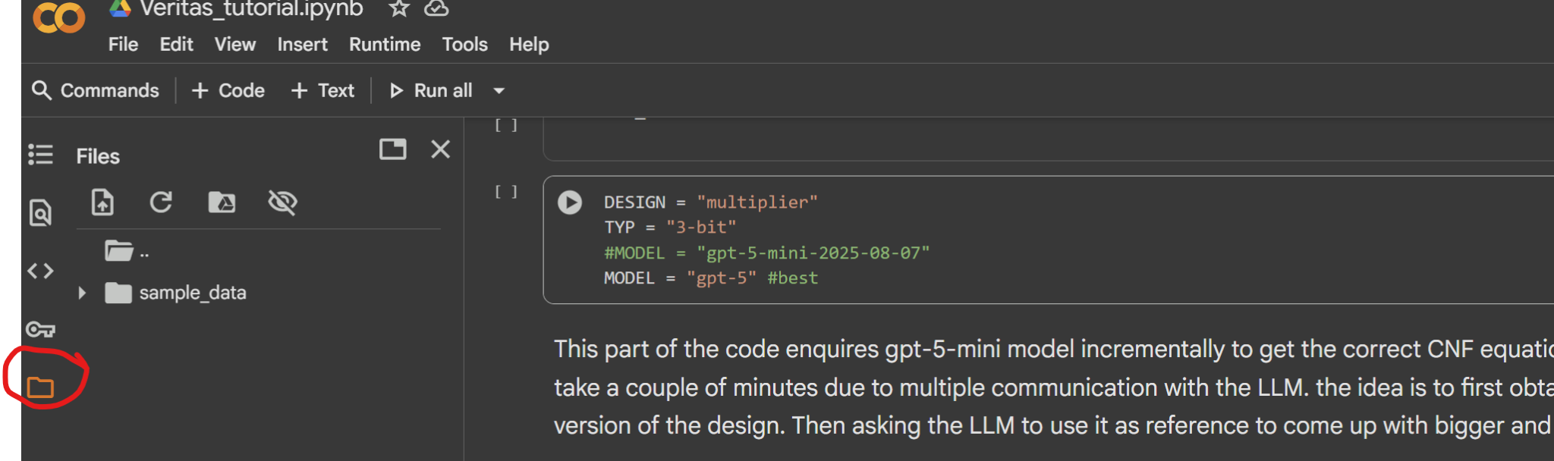
Try out veritas collab - generating bench
The second block in the collab notebook converts the cnf equations to equivalent .bench file.
You have to ensure that you have declared the input and the output variable initially in the block.
Check for the generated .bench files in the folder icon present on the left side of the collab notebook

Slide 18
Try out veritas collab - simulating bench
As an easy way to check whether the generated bench is derived from correct CNF, I have provided a simulation script in the third block
This script generates a truth table for the circuit, which can be quickly checked to verify the functionality of the bench
It is a quick way to verify the functionality for small circuits
For bigger circuits we can use cec, but for that you have to call the “cec” tool on your linux machine, can not use it on collab directly

Slide 19
Try out veritas collab - bench to verilog
The fourth block of the collab contains the script to deterministically convert the bench to its equivalent verilog file
The generated verilog file will also show up under the folder icon to the left

Slide 20
Try out veritas collab
Subash your slides go here!

Slide 21
Try out veritas collab
Dhirajen Your slides go here!

Slide 22
Generative Models and Verilog Generation
LLMs vastly used around the world for coding
Can LLMs be used for Hardware Code generation?
Some Approaches
DAV
ChipChat
Verigen
Trained CodeGen-2b and 16Bs on Verilog from github and text books
Performed better than the contemporary state-of-the-art GPT3.5
AutoChip
RTL Coder
Used 27k prompt and solution pairs for training
SoTA with the highest pass@k values

Slide 23
Limitations of Verilog Trained Models
Numerous Syntax Errors
Verification after generating the verilog
Involves human intervention for testing

Slide 24
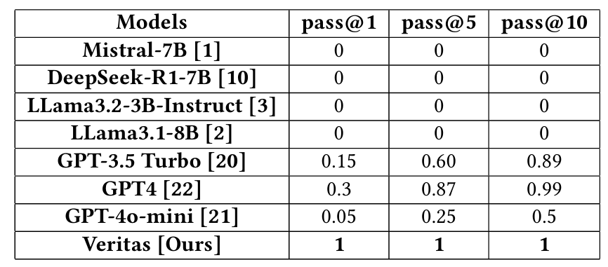
Case 1: CNF Generation by Base Models

Slide 25
Leveraging The Thinking Power of LLMs
Thinking models can process large contexts and identify repeating patterns. They build on concepts when given a few examples.
Incremental prompting: Construct large designs incrementally. Provide smaller examples of the same design→ allows model to scale up.

Slide 26
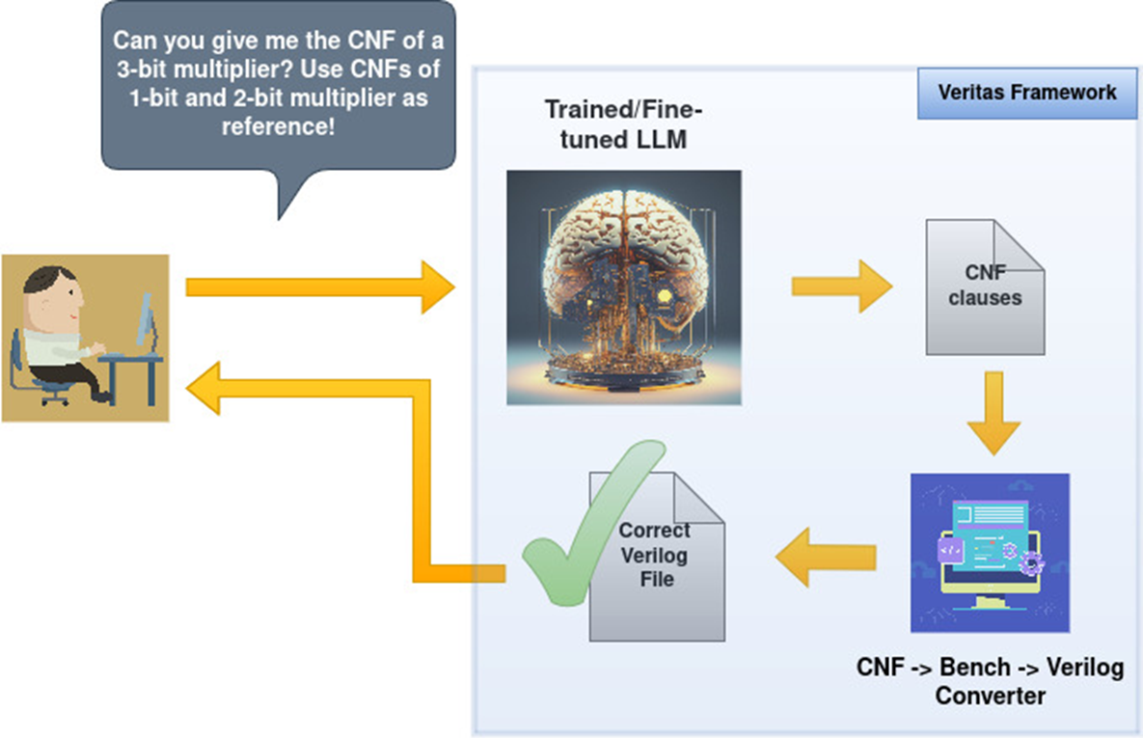
Incremental Prompting

Slide 27
Incremental Prompting to Generating Circuits
Step – 1: Base Prompting
Give me the CNF (conjunctive normal form) equation for a 1-bit full adder. Assume inputs A, B, Cin and outputs S (sum) and Cout (carry-out). Use ∧ for AND, ∨ for OR, and ! for NOT while giving the CNF equation. Just return the equations for S and Cout
Response:
S = (!A ∨ B ∨ Cin ∨ S) ∧ (A ∨ !B ∨ Cin ∨ S) ∧ (A ∨ B ∨ !Cin ∨ S) ∧ (!A ∨ !B ∨ !Cin ∨ S) ∧ (A ∨ B ∨ Cin ∨ !S) ∧ (!A ∨ !B ∨ Cin ∨ !S) ∧ (!A ∨ B ∨ !Cin ∨ !S) ∧ (A ∨ !B ∨ !Cin ∨ !S)
Cout = (!A ∨ !B ∨ Cin ∨ Cout) ∧ (!A ∨ B ∨ !Cin ∨ Cout) ∧ (A ∨ !B ∨ !Cin ∨ Cout) ∧ (!A ∨ !B ∨ !Cin ∨ Cout) ∧ (A ∨ B ∨ Cin ∨ !Cout) ∧ (!A ∨ B ∨ Cin ∨ !Cout) ∧ (A ∨ !B ∨ Cin ∨ !Cout) ∧ (A ∨ B ∨ !Cin ∨ !Cout)

Slide 28
Incremental Prompting to Generate Circuits
Step–2 Teaching Prompting:
Using the CNF equation for a 1-bit adder, construct a 2-bit adder. Equation of 1-bit adder is : “+base prompt response+". Just return the CNF equations.
Response:
S0 = (!A0 ∨ B0 ∨ Cin ∨ S0) ∧ (A0 ∨ !B0 ∨ Cin ∨ S0) ∧ (A0 ∨ B0 ∨ !Cin ∨ S0) ∧ (!A0 ∨ !B0 ∨ !Cin ∨ S0) ∧ (A0 ∨ B0 ∨ Cin ∨ !S0) ∧ (!A0 ∨ !B0 ∨ Cin ∨ !S0) ∧(!A0 ∨ B0 ∨ !Cin ∨ !S0) ∧ (A0 ∨ !B0 ∨ !Cin ∨ !S0)
C1 =(!A0 ∨ !B0 ∨ Cin ∨ C1) ∧ (!A0 ∨ B0 ∨ !Cin ∨ C1) ∧ (A0 ∨ !B0 ∨ !Cin ∨ C1) ∧ (!A0 ∨ !B0 ∨ !Cin ∨ C1) ∧ (A0 ∨ B0 ∨ Cin ∨ !C1) ∧ (!A0 ∨ B0 ∨ Cin ∨ !C1) ∧(A0 ∨ !B0 ∨ Cin ∨ !C1)∧(A0 ∨ B0 ∨ !Cin ∨ !C1)
S1=(!A1 ∨ B1 ∨ C1 ∨ S1) ∧ (A1 ∨ !B1 ∨ C1 ∨ S1) ∧ (A1 ∨ B1 ∨ !C1 ∨ S1) ∧ (!A1 ∨ !B1 ∨ !C1 ∨ S1) ∧ (A1 ∨ B1 ∨ C1 ∨ !S1) ∧ (!A1 ∨ !B1 ∨ C1 ∨ !S1) ∧ (!A1 ∨ B1 ∨ !C1 ∨ !S1) ∧ (A1 ∨ !B1 ∨ !C1 ∨ !S1)
Cout=(!A1 ∨ !B1 ∨ C1 ∨ Cout) ∧ (!A1∨B1∨!C1∨Cout)∧(A1∨!B1 ∨!C1 ∨Cout) ∧ (!A1∨!B1 ∨ !C1 ∨ Cout) ∧ (A1∨B1∨C1∨!Cout) ∧ (!A1∨B1∨C1∨!Cout)∧(A1∨!B1∨C1∨!Cout)∧(A1 ∨ B1 ∨ !C1 ∨ !Cout)

Slide 29
Incremental Prompting to Generate Circuits
•Step – 3: Final Prompting:
Using CNF equation for a 1-bit adder: "+base prompt response+" and the equation of a 2-bit adder: "+teaching prompt response+". Construct a "+n-bit+" adder. Just return the CNF equations as <output> = <CNF equation>.
Response:
S0 = (!A0 ∨ B0 ∨ Cin ∨ S0) ∧ (A0 ∨ !B0 ∨ Cin ∨ S0) ∧ (A0 ∨ B0 ∨ !Cin ∨ S0) ∧(!A0 ∨ !B0 ∨ !Cin ∨ S0) ∧ (A0 ∨ B0 ∨ Cin ∨ !S0) ∧ (!A0 ∨ !B0 ∨ Cin ∨ !S0) ∧(!A0 ∨ B0 ∨ !Cin ∨ !S0) ∧ (A0 ∨ !B0 ∨ !Cin ∨ !S0)
C1 = (!A0 ∨ !B0 ∨ Cin ∨ C1) ∧ (!A0 ∨ B0 ∨ !Cin ∨ C1) ∧ (A0 ∨ !B0 ∨ !Cin ∨ C1) ∧ (!A0 ∨ !B0 ∨ !Cin ∨ C1) ∧ (A0 ∨ B0 ∨ Cin ∨ !C1) ∧ (!A0 ∨ B0 ∨ Cin ∨ !C1) ∧(A0 ∨ !B0 ∨ Cin ∨ !C1) ∧ (A0 ∨ B0 ∨ !Cin ∨ !C1)
……………………………………………………………..
S2 = (!A2 ∨ B2 ∨ C2 ∨ S2) ∧ (A2 ∨ !B2 ∨ C2 ∨ S2) ∧ (A2 ∨ B2 ∨ !C2 ∨ S2) ∧ (!A2 ∨ !B2 ∨ !C2 ∨ S2) ∧ (A2 ∨ B2 ∨ C2 ∨ !S2) ∧ (!A2 ∨ !B2 ∨ C2 ∨ !S2) ∧ (!A2 ∨ B2 ∨ !C2 ∨ !S2) ∧ (A2 ∨ !B2 ∨ !C2 ∨ !S2)
Cout = (!A2 ∨ !B2 ∨ C2 ∨ Cout) ∧ (!A2 ∨ B2 ∨ !C2 ∨ Cout) ∧ (A2 ∨ !B2 ∨ !C2 ∨ Cout) ∧ (!A2 ∨ !B2 ∨ !C2 ∨ Cout) ∧ (A2 ∨ B2 ∨ C2 ∨ !Cout) ∧ (!A2 ∨ B2 ∨ C2 ∨ !Cout) ∧ (A2 ∨ !B2 ∨ C2 ∨ !Cout) ∧ (A2 ∨ B2 ∨ !C2 ∨ !Cout)

Slide 30
Case Study 2: Generate circuits on GPT5 thinking model using incremental prompting
Successfully generated 2-8 bit adders
Successfully generated 2-8 bit subtractors
Successfully generated 2x1 to 16x1 MUXes
Successfully generated 2x4 to 5x32 Decoders

Slide 31
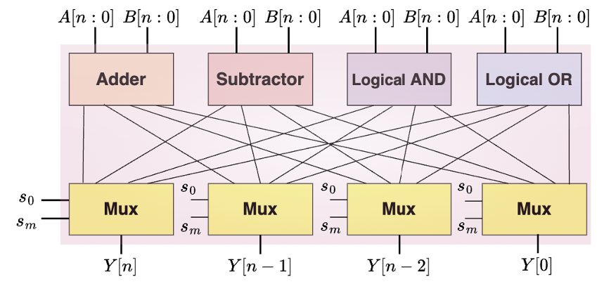
Case Study 3: Generate a small ALU

Slide 32
PLF ↔ Logic Design
Logic designs can be represented as a conjunction of Tseytin transformations of basic gates. (https://en.wikipedia.org/wiki/Tseytin_transformation)
From the PLF corresponding verilog of the design can be obtained

Slide 33
VeriCNF Flow Stage 1: Preprocessing
Training Data Set: Combinations of Prompt + CNF or Prompt + PLF.
Later takes less tokens.
Prompt: Give me a 1-bit full adder with input a,b, cin and outputs sum, cout
sum = (a ∨ b ∨ ¬ab_xor) ∧ (a ∨ ¬b ∨ ab_xor) ∧ (¬a ∨ b ∨ ab_xor) ∧
(¬a ∨ ¬b ∨ ¬ab_xor) ∧ (ab_xor ∨ cin ∨ ¬sum) ∧ (ab_xor ∨ ¬cin ∨ sum) ∧ (¬ab_xor ∨ cin ∨ sum) ∧ (¬ab_xor ∨ ¬cin ∨ ¬sum)
cout = (¬a ∨ ¬b ∨ cout) ∧ (¬a ∨ ¬cin ∨ cout) ∧ (¬b ∨ ¬cin ∨ cout)
∧ (a ∨ b ∨ ¬cout) ∧ (a ∨ cin ∨ ¬cout) ∧ (b ∨ cin ∨ ¬cout)
Prompt: Give me a 1-bit full adder with input a,b, cin and outputs sum, cout
sum↔(a∧¬b∧¬cin) ∨ (¬a∧b∧¬cin) ∨ (¬a∧¬b∧cin) ∨ (a∧b∧cin)
cout↔(a∧b) ∨ (cin∧(a∨b))
Notes:
Can you explain this step with a verilog and equivalent Tseytin, CNF, and PLF formulae

Slide 34

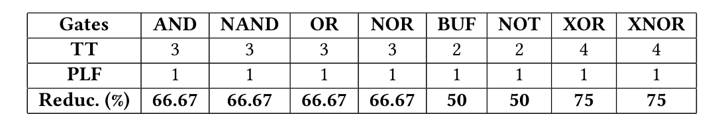
Tseytin Expressions are Large:
Use Propositional Logic Formulas (PLF)
Tseytin Expression of XOR
Equivalent Propositional Logic Formula (PLF) of XOR

Slide 35
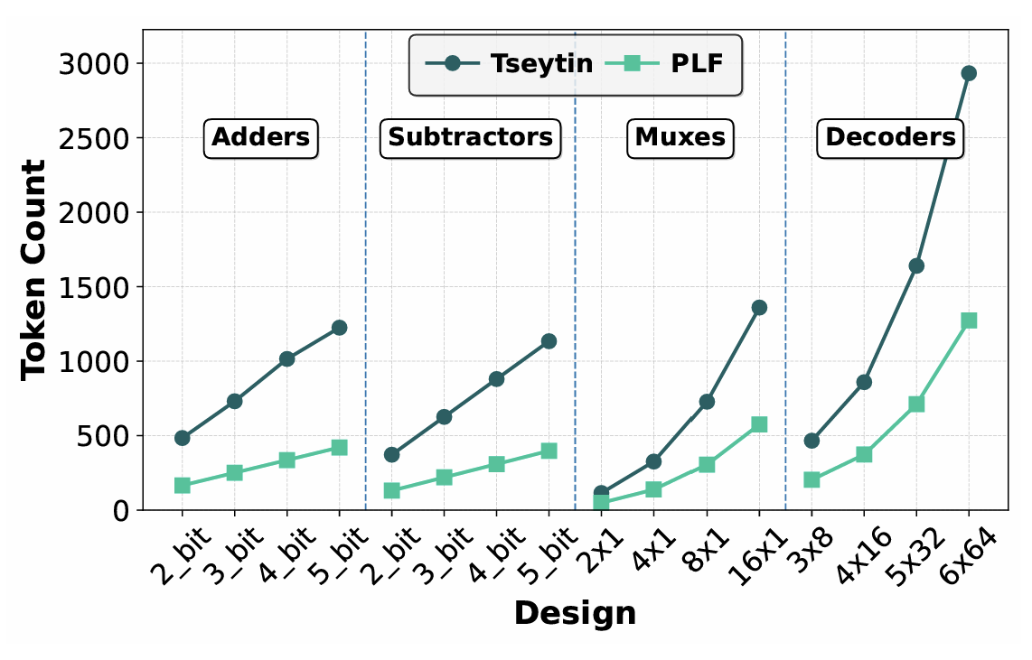
Tseytin and PLFs in terms of tokens

Slide 36
VeriCNF Flow Stage 1: Preprocessing
Reference verilog is converted to PLF gate-by-gate. # of clauses and tokens for PLF is less than that for CNF
// Full Adder (gate-level)
module full_adder_gate (
input wire a,
input wire b,
input wire cin,
output wire sum,
output wire cout
);
// internal wires
wire ab_xor;
wire a_and_b, b_and_cin, a_and_cin;
// XOR chain for sum
xor (ab_xor, a, b); // ab_xor = a ^ b
xor (sum, ab_xor, cin);// sum = (a ^ b) ^ cin
// AND-OR network for carry out
and (a_and_b, a, b); // a&b
and (b_and_cin, b, cin); // b&cin
and (a_and_cin, a, cin); // a&cin
or (cout, a_and_b, b_and_cin, a_and_cin); // cout = a&b | b&cin | a&cin
endmodule
sum↔(a∧¬b∧¬cin) ∨ (¬a∧b∧¬cin) ∨ (¬a∧¬b∧cin) ∨ (a∧b∧cin)
cout↔(a∧b) ∨ (cin∧(a∨b))
Notes:
Can you explain this step with a verilog and equivalent Tseytin, CNF, and PLF formulae

Slide 37
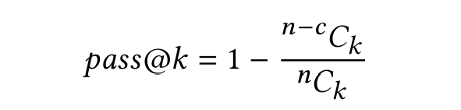
Evaluate Generated Verilog – pass@k

Slide 38
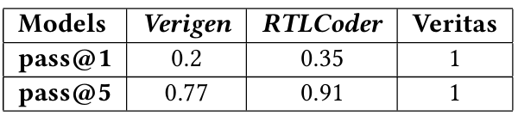
Comparison with SoTA

